Slide 1

First Responder Use Case dieter.gawlick@oracle.com
March, 2008

Slide 2
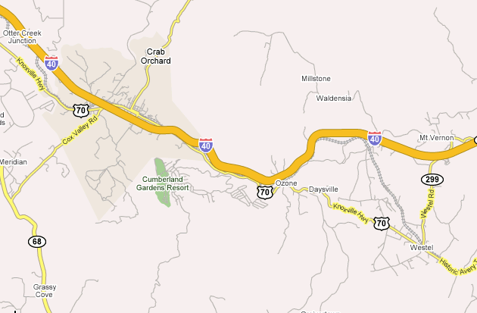






Simple Scenario
911 Center
Supporting Services
Accident @ x - investigate
Accident
Accident ahead
Accident @ x - standby
Fire Station

Slide 3
Simple Scenario
Accident happens
911 center notified
  Automatic determination of location preferred
  Automatic notification preferred; e.g., car could send message while deploying air bags
Closest police car – in terms of driving time – is automatically dispatched
Closest paramedics/ambulance is automatically notified - standby
Paramedics/ambulance are dispatched if required
Cars behind accident are automatically notified

Slide 4
Simple Scenario
Other
Drivers
Supporting
Services
Car
Sensor
Police
Officer
Police
officer
911 Center
Ambulance
Witness
Dictionary*
Paramedics
Car sensors
Police officers
Ambulances, Paramedics
Subscriptions
Supporting services
Towing Service
Sources
Processes
Sinks
* Dictionary technology based on INFOD, https://forge.gridforum.org/sf/go/doc13627?nav=1

Slide 5





Complex Scenario - 1
ABC Chemicals
County Office
Hospital
Fire Station
Fire Station

Slide 6
Complex Scenario - 1
Fire starts, is reported and assessed
First responders are informed and dispatched
Population is warned to evacuate depending on distance – how do visitors know the distance?
Note:
  Evacuation effects a large population
  Evacuation distances are potentially large
  Train and hospital are evacuated
    Significant resources are used without need
    Hospital could be used as an asset

Slide 7


Complex Scenario - 2
ABC Chemicals
County Office
Hospital
Notification Message
Fire Station
Fire Station

Slide 8
Complex Scenario - 2
Fire starts, sensors report chemical exposure
Impact is calculated based on sensor data and whether model
  A spatial, temporal model of the chemical plume is created and constantly updated
  Extended down-wind and reduced up-wind exposure is recognized
First responders are informed and dispatched
Population is warned to evacuate depending on location
  Message:
    What incident (generic – accident – plume map)
    What does it mean to the individual consumer (specific evacuation route)
Note:
  Evacuation effects only population in danger
  Evacuation distances are mostly small – less or no traffic jams
  Train and hospital are OK, hospital is a resource

Slide 9

Complex Scenario - 2
Local
Residents
Supporting
Services
Weather
Service
Visitors
Weather
Stations
CEP
Filter
Plume
Calculation
Drivers
911 Center
Chemical
Sensors
First
Responders
Dictionary
Sensors
Hospitals, First Responders
Supporting Services
Subscriptions
Witness
Reports
Sources
Processes
Sinks

Slide 10
Complex Scenario - 2
Assess exposure of people based on condition at the time of the incident - weather condition, actual location of people
  Optimize use of resources
  Optimize evacuation
  Identify people that are at risk - not too many, not too few
  Reduce impact on people not at risk
Encourage new ideas for GPS enabled devices
    Download risk map
    Activate devices even while they are turned off
    Provide virtual GPS service for none GPS devices

